Slide 1
Feature Selection of Image Classification based on New Ranking Criterion
Team:
Guide:
A. Akshay - 15B81A0513
K. Anush - 15B81A0525 G. Ramya
B. Harish - 15B81A0557

Slide 2
Abstract
A feature selection method combining the reliefF and SVM-RFE algorithm is proposed. This algorithm integrates the weight vector from the reliefF into SVM-RFE method. In this method, the reliefF filters out many noisy features in the first stage. Then the new ranking criterion based on SVM-RFE method is applied to obtain the final feature subset. The SVM classifier is used to evaluate the final image classification accuracy. Experimental results show that our proposed relief- SVM-RFE algorithm can achieve significant improvements for feature selection in image classification.

Slide 3

Introduction
Feature Selection:
Feature Selection is one of the core concepts in machine learning which hugely impacts the performance of a data model.

Slide 4
Feature selection plays a key role in many pattern recognition problems such as image classification. While a great many of features can be utilized to characterize an image, only a few number of them are efficient and effective in classification. More features does not always lead to a better classification performance, thus feature selection is usually performed to select a compact and relevant feature subset in order to reduce the dimensionality of feature space, which will eventually improves the classification accuracy and reduce time consumption.
Feature selection is different from dimensionality reduction. Both methods seek to reduce the number of attributes in the dataset, but a dimensionality reduction method will do so by creating new combinations of attributes, where as feature selection methods include and exclude attributes present in the data without changing them.

Slide 5
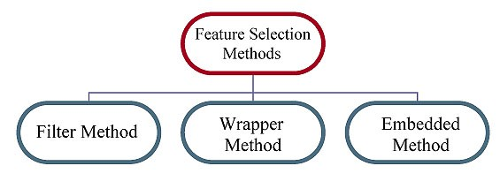
Types of Feature Selection Algorithms:
Based on different evaluation criterion, feature selection methods can be classified to three categories: filter models, wrapper models and embedded models.
Filter Models:
Filter feature selection methods apply a statistical measure to assign a scoring to each feature. The features are ranked by the score and either selected to be kept or removed from the dataset. The methods are often univariate and consider the feature independently, or with regard to the dependent variable. Some examples of some filter methods include the Chi squared test, reliefF, information gain and correlation coefficient scores.

Slide 6
Wrapper Methods:
Wrapper methods consider the selection of a set of features as a search problem, where different combinations are prepared, evaluated and compared to other combinations. A predictive model us used to evaluate a combination of features and assign a score based on model accuracy. An example if a wrapper method is the recursive feature elimination (RFE) algorithm.
Embedded Methods:
Embedded methods learn which features best contribute to the accuracy of the model while the model is being created. The most common type of embedded feature selection methods are regularization methods. Examples of regularization algorithms are the LASSO, Elastic Net and Ridge Regression.

Slide 7
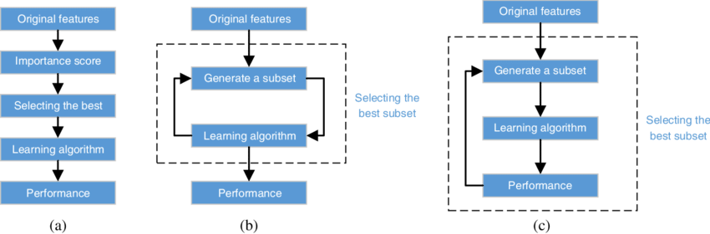
Filter method
Wrapper Method
Embedded method

Slide 8
Objective
A new hybrid model is proposed by combing reliefF algorithm and SVM-RFE method. The new method (we call it reliefF-SVM-RFE) not only performs better than either of the two methods but also costs much less computational time than the wrapper models.
The integration of reliefF and SVM-RFE leads to an effective feature selection scheme. In the first stage, reliefF is applied to find a subset of candidate features so that many irrelevant features are filtered out and the computational demands can be reduced. In the second stage, SVM-RFE method is applied to directly estimate the quality of each feature resulted from the reliefF algorithm according to our proposed evaluation criterion.

Slide 9
Program Language Used: R Programming
Package Used: Caret R
The caret package (short for Classification And REgression Training) contains functions to streamline the model training process for complex regression and classification problems. The package utilizes a number of R packages but tries not to load them all at package start-up (by removing formal package dependencies, the package startup time can be greatly decreased).
Dataset Used: Caltech-256 image dataset
URL: https://authors.library.caltech.edu/7694/
It is a dataset of 256 object categories consisting of 30607 images.

Slide 10
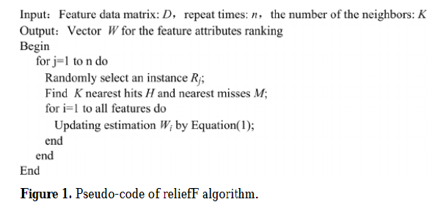
Working Model
Step 1) relief Algorithm:
ReliefF is a simple yet efficient procedure to estimate the quality of feature in problems with strong dependencies between attributes. In practice, reliefF is usually applied in data pre-processing for selecting a feature subset.
The key idea of the reliefF is to estimate the quality of feature according to how well their values distinguish between instances that are near to each other.

Slide 11
Step 2) SVM-RFE Algorithm:
The SVM-RFE for feature selection is a feature elimination method based on SVM classifier and capable of selecting a small feature subset. It starts with all the feature components and recursively removes the feature components with the least importance for the classification in a backward elimination manner. In the original SVM-RFE method, the ranking criterion is computed from the weight vector of SVM.
Steps Involved are:
Train a data model
Compute a ranking of features
Remove the feature with the Worst Rank

Slide 12
Step 3) Improvised algorithm by combining reliefF and SVM-RFE:
As we mentioned before, reliefF is a general and successful feature attributes estimator and is able to effectively provide quality estimation of features in problem with dependencies between feature attributes.
However reliefF does not explicitly consider the role of classifier in feature extraction. On the other hand, the SVM-RFE algorithm totally takes the importance of classifier into account, it is computationally expensive.
Thus it could be helpful to integrate the weight vector from reliefF into SVM-RFE method. Therefore, we devise a new ranking criterion.

Slide 13
Conclusion:
In this method, the reliefF method is employed to filter out many noisy feature components and obtain an effective candidate feature subset, then the new evaluation criterion integrating those from the reliefF method and the SVM-RFE is applied to select the final feature components.
Experimental results demonstrate that with the feature subset from our proposed reliefF-SVM-RFE method a better classification performance can be achieved.

Slide 14
THANK YOU

